Slide 1


Data Observability Model A Comprehensive Framework for Data Observability Model
Notes:
This presentation provides an overview of a structured, model-driven approach to ensuring data integrity and extracting actionable insights. Our model is divided into six quadrants.

Slide 2



Agenda
Introduction
Key Performance Indicators (KPI)
Quadrants

Slide 3
Introduction
This presentation provides an overview of a structured, model-driven approach to ensuring data integrity and extracting actionable
insights. Our model is divided into six quadrants.
Quadrant 1
Quadrant 2
Quadrant 3
1
2
3
Time series anomalies and root causes.
Structural changes in the dataset.
Data freshness status.
Quadrant 4
Quadrant 5
Quadrant 6
4
5
6
Restatement between Datasets
Unknows Unknowns.
Data Validations Checks.

Slide 4



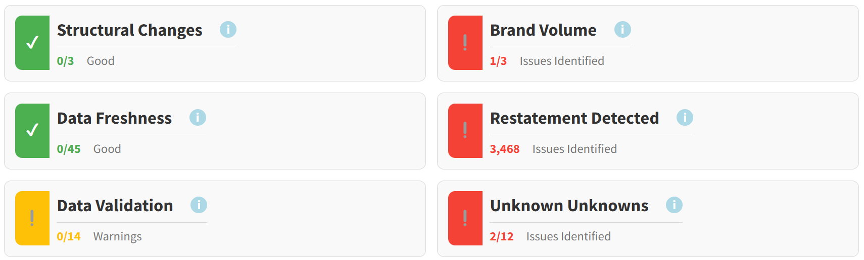
Key Performance Indicators (KPI)
Purpose
Methodology
Outcome
To measure and track the performance of all six Quadrant of the Model
Track each and every quadrant of the model, indicating the status as Good, Warning, or Issues Identified. For issues identified, use an I icon to provide detailed information.
Provides clear insights into how the model is performing.

Slide 5
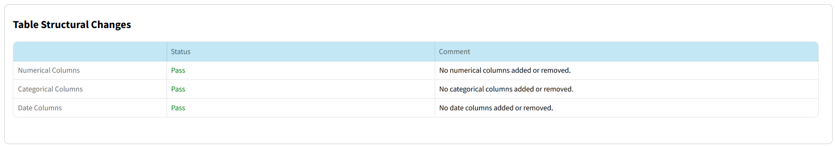
Quadrant 1 – Table Structural Changes
Purpose
Methodology
Outcome
Ensure structural integrity and identify discrepancies.
.
Compare the structure of two datasets and check for structural changes, such as whether any numerical, categorical, or date columns have been added or removed.
Maintain consistency and track changes.

Slide 6
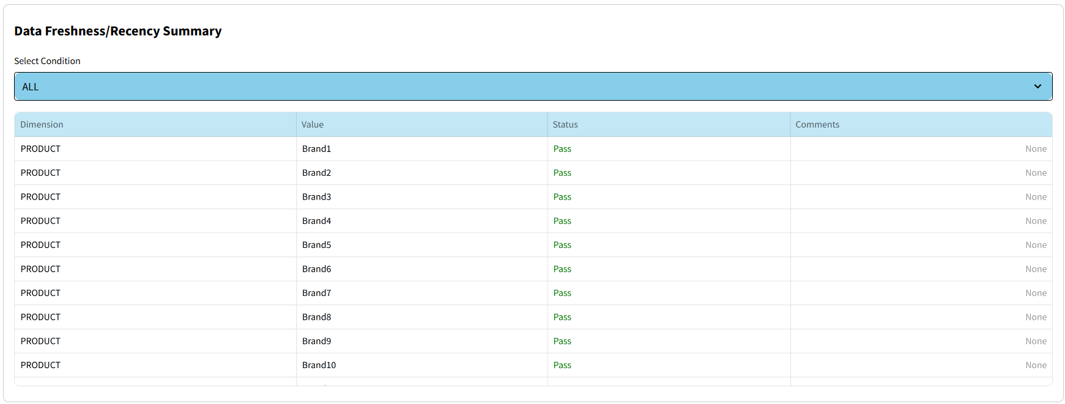
Quadrant 2 – Data Freshness
Purpose
Methodology
Outcome
Ensure data is up-to-date and relevant.
.
Analyze the most recent timestamps in the dataset and check each unique value of the dimension against the timestamps, showing the status as pass or fail.
Maintain the freshness of the data..

Slide 7
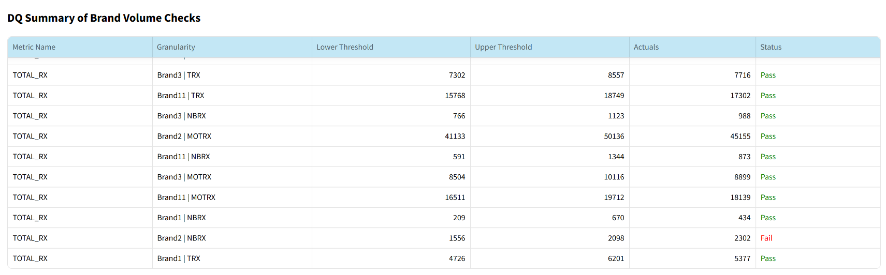
Quadrant 3 – Time Series Analysis (Brand Volume Check)
Purpose
Methodology
Outcome
Identify irregularities and understand their root causes.
Apply the Prophet model to analyze time series data and find anomalies using the lower and upper thresholds generated by Prophet. Check these against actual values to identify the anomalies and perform root cause analysis to find the reasons behind them.
Enhanced understanding of brand performance.

Slide 8
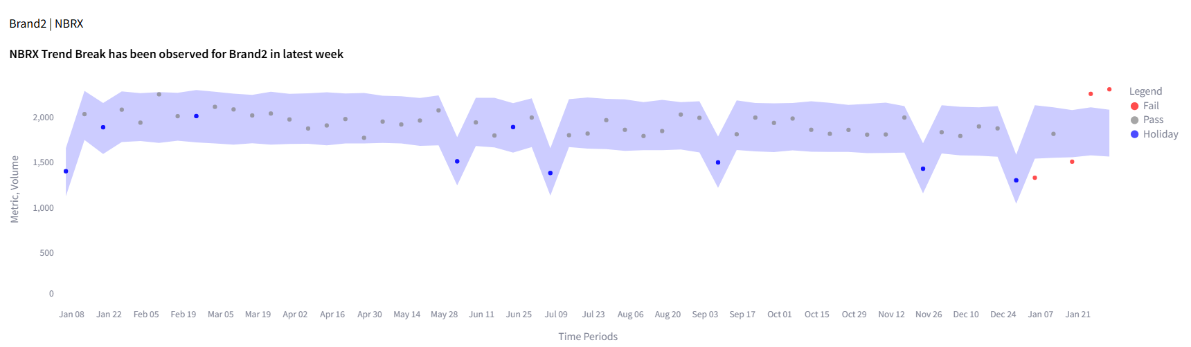
Brand Volume Visualization
This is the graphical representation of the Prophet model chart. In this chart, the Prophet model generates the lower and upper thresholds shown in the blue area. The grey dots represent the normal points, the blue dots indicate holiday points that show seasonality trends, and the red dots mark anomalies. When you hover over a red dot, it displays the root cause of the anomaly.

Slide 9
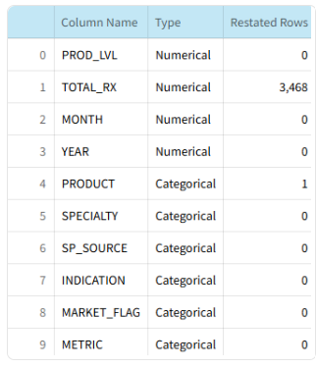
Quadrant 4 – Restatement Analysis
Purpose
Methodology
Outcome
Identify restatements and ensure reliability.
Use a Gradient Regressor model to compare two financial datasets to find restatements in each column, including both categorical and numerical columns.
Maintain trust in data and accurate reporting.

Slide 10
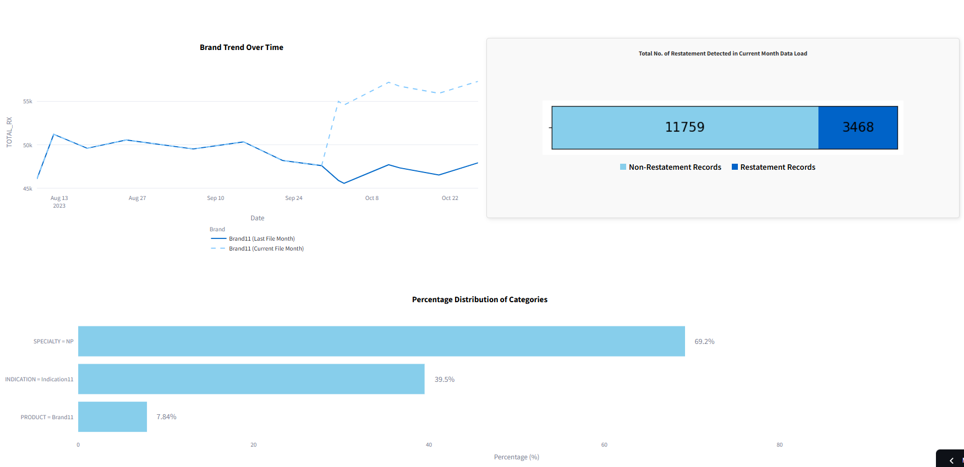
Restatement Analysis Visualization
This is the graphical representation of the restatement analysis, which compares the previous file and the current file to detect restatements over time. It shows the number of non-restatement records and restatement records using a stacked bar chart, and also performs restatement analysis to find the root cause of the restatements.

Slide 11
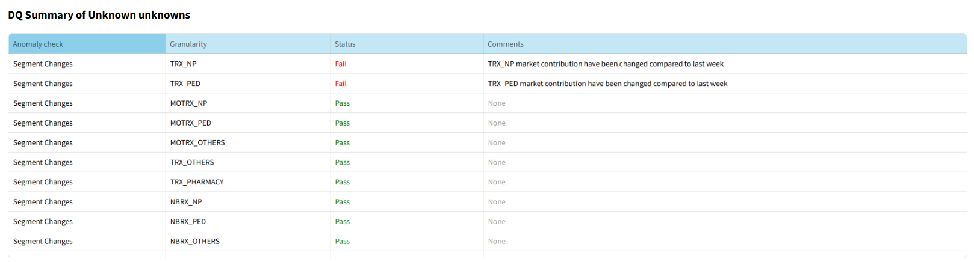
Quadrant 5 – Unknown Unknowns
Purpose
Methodology
Outcome
Uncover unexpected patterns in the data.
.
Calculate contribution percentages for combinations using Prophet to find the Unknown Unknowns in the data set
Provides insight into potential areas of concern

Slide 12
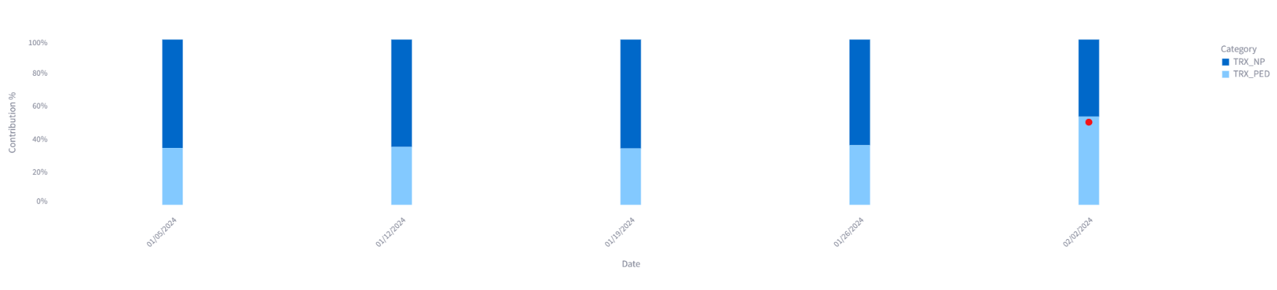
Unknown Unknowns Visualization
This is the graphical representation of the Unknown Unknowns using a bar chart. It shows the percentage contribution of different brands. If there is any sudden decrease or increase in the contribution, it flags these as anomalies and marks them with a red dot on the bar. When you hover over a red dot, it displays the percentage increase or decrease in the contribution.

Slide 13
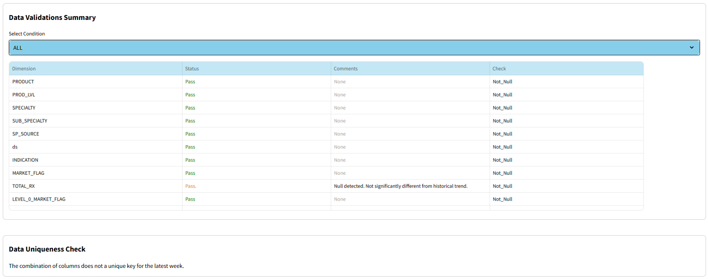
Quadrant 6 – Data Validation
Purpose
Methodology
Outcome
To ensure the accuracy, quality, and reliability of the data being used..
.
Perform a Not Null check by comparing the data with historical data to identify null values and calculate the percentage of null values according to historical data. Also, check for table-level uniqueness.
A dataset that is consistent, accurate, and ready for analysis or other processing.

